Slide 1
AXILLA
DR OMOTAYO H A

Slide 2
CONTENTS
Definition
Boundaries
Contents
Axillary Vessels
Applied anatomy

Slide 4
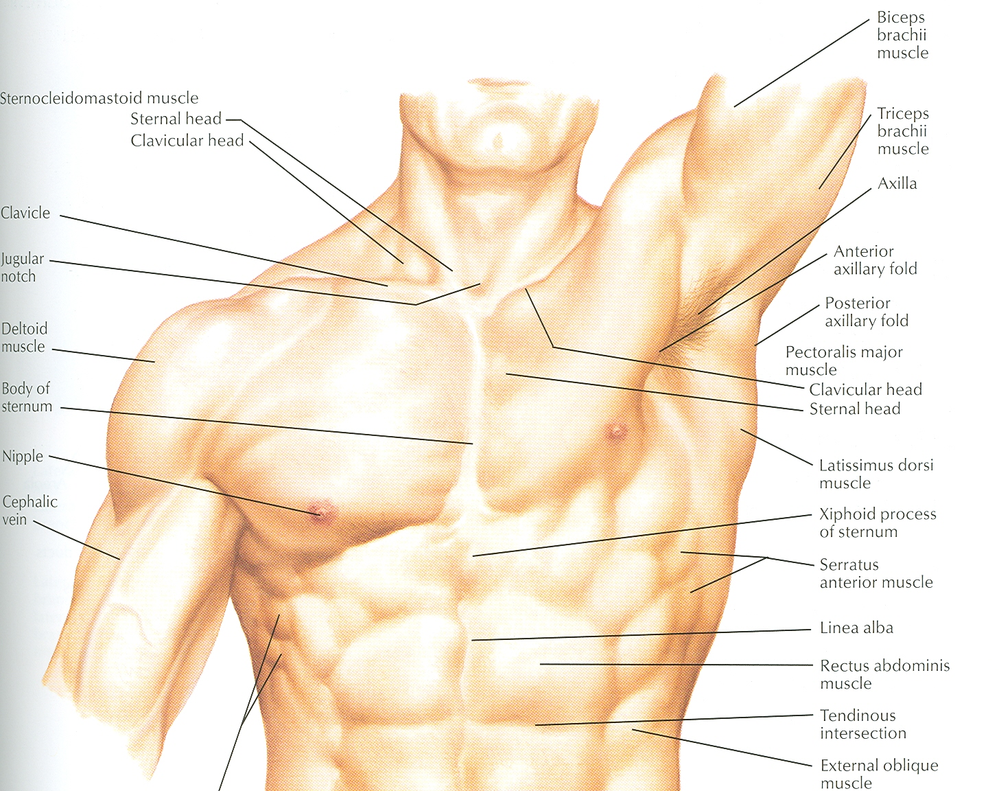
AXILLA

Slide 5
Definition
It is a pyramid shaped space between the upper part of the arm and the side of the chest
Important Nerves, Blood and Lymph vessels travel through it from root of the neck to the upper limb

Slide 6
Apex
Upper end of axilla or APEX is directed into the root of neck
Bounded in front by the clavicle
Behind by upper border of scapula
Medially by outer border of the 1st rib

Slide 7
Base
Lower end or Base is bounded in front by the anterior axillary fold formed by pectoralis major muscle
Behind by posterior axillary fold formed by the tendons of latissimus dorsi and teres major muscles
Medially by the chest wall

Slide 8
Walls of The Axilla
Anterior wall:
By the pectoralis major, Subclavius and pectoralis minor muscles
Posterior wall:
By the subscapularis, Latissimus dorsi and teres major muscles

Slide 9
Walls of The Axilla
Medial wall:
By the upper 4 or 5 ribs and intercostal spaces covered by serratus anterior muscle
Lateral wall:
By the coracobrachialis and biceps muscles in the bicipital groove of humerus

Slide 10
Base
The Base of axilla is formed by the skin
stretching between the anterior and
posterior walls

Slide 11
Clavipectoral Fascia
It is a strong sheet of connective tissue
Split above to enclose the subclavius muscle and is attached to the clavicle
Below it splits to enclose the pectoralis minor muscle
Then continues downward as the suspensory ligament of the axilla
Then joins the fascial floor of armpit

Slide 12
Contents of Axilla
Axillary artery and its branches
Axillary vein and its tributaries
Lymph vessels and lymph nodes
Important nerve plexus the “Brachial Plexus” which innervates the upper limb

Slide 13
Axillary Artery
Is a continuation of subclavian artery
Begins at the lateral border of the 1st rib
Ends at the lower border of teres major
It continues as the brachial artery
Closely related to brachial plexus cords
Enclosed with them in the axillary sheath
Axillary sheath is continuous with the prevertebral fascia
Pectoralis minor divides it into 3 parts

Slide 14
1st Part of Axillary Artery
Extends from the lateral border of the 1st
rib to the upper border of pectoralis minor

Slide 15
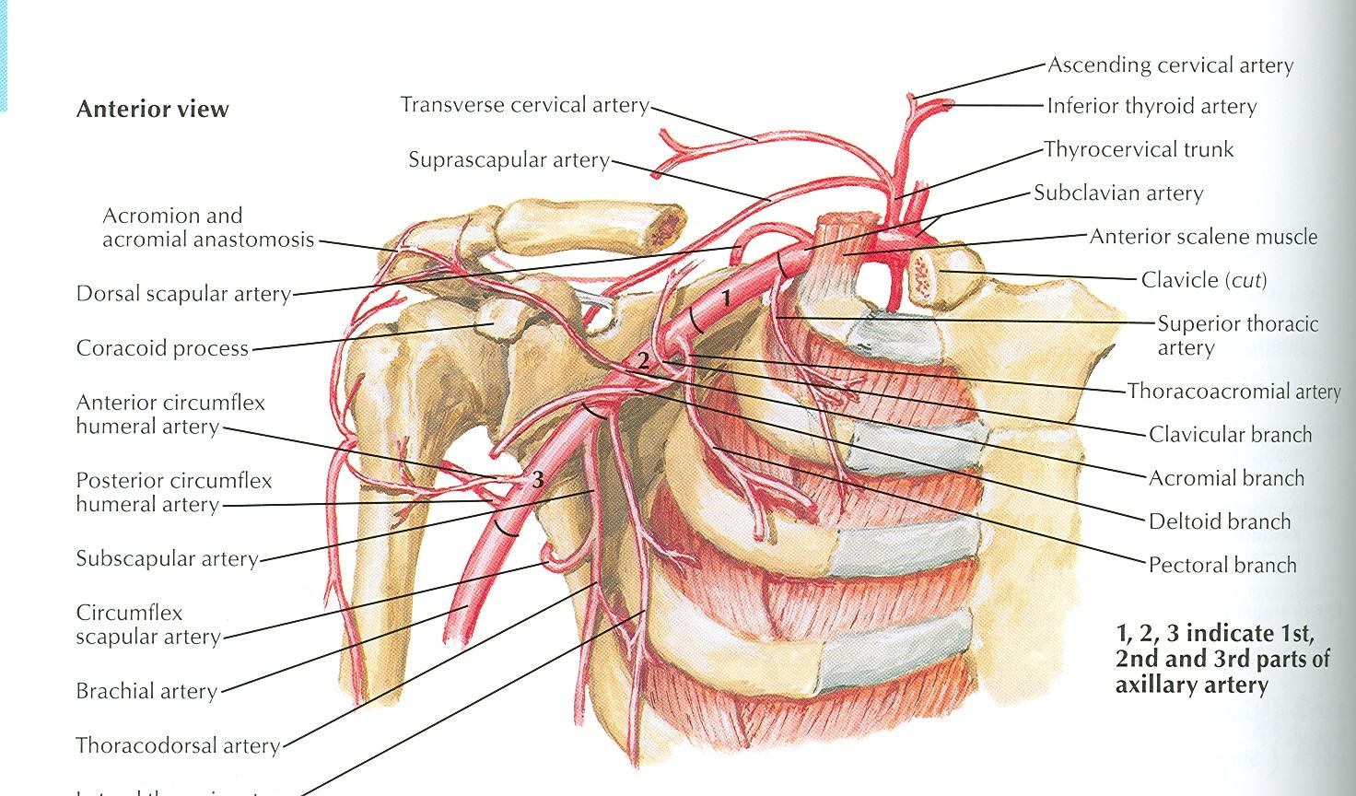

Slide 16
Relation
Anterior: Pectoralis major, covering fascia, skin, cephalic vein
Posterior: Long thoracic nerve
Lateral: Three cords of brachial plexus
Medial: Axillary vein

Slide 17
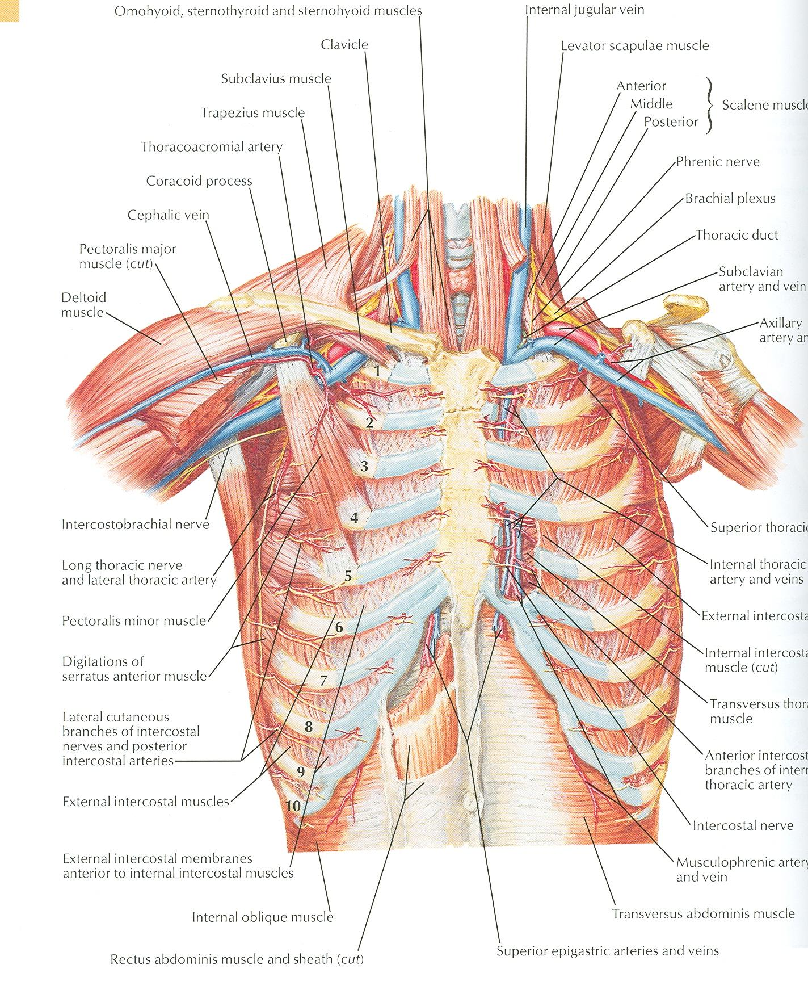
2nd Part of Axillary Artery
Lies behind the pectoralis minor muscle

Slide 18
Relation
Anterior: Pectoralis minor and major, covering fascia and skin
Posterior: Posterior cord of brachial plexus
Lateral: Lateral cord of brachial plexus
Medial: medial cord of brachial plexus and axillary vein

Slide 19
3rd Part of Axillary Artery
Extends from lower border of pectoralis minor to the lower border of teres major

Slide 20
Relation
Anterior: Pectoralis major, medial root of the median nerve
Posterior: subscapularis, latissimus dorsi and teres major
Lateral: Coracobrachialis, biceps, humerus
Medial: Ulnar nerve, axillary vein, medial cutaneous nerve of the arm

Slide 21
Branches
Branches of axillary artery supply the thoracic wall and the shoulder region
1st Part: Highest thoracic artery
2nd Part: Thoracoacromial and lateral thoracic arteries
3rd Part: Subscapular artery, anterior and posterior circumflex humeral arteries

Slide 22
Pectoralis Major
Origin: Medial half of clavicle, sternum, upper 6 costal cartilages
Insertion: Lateral lip of bicipital groove of the humerus
NS: Medial and Lateral pectoral Nerve from medial and lateral pectoral cords of brachial plexus
Action: Adducts the arm and rotates it medially, some fibers also cause flexion of arm

Slide 23
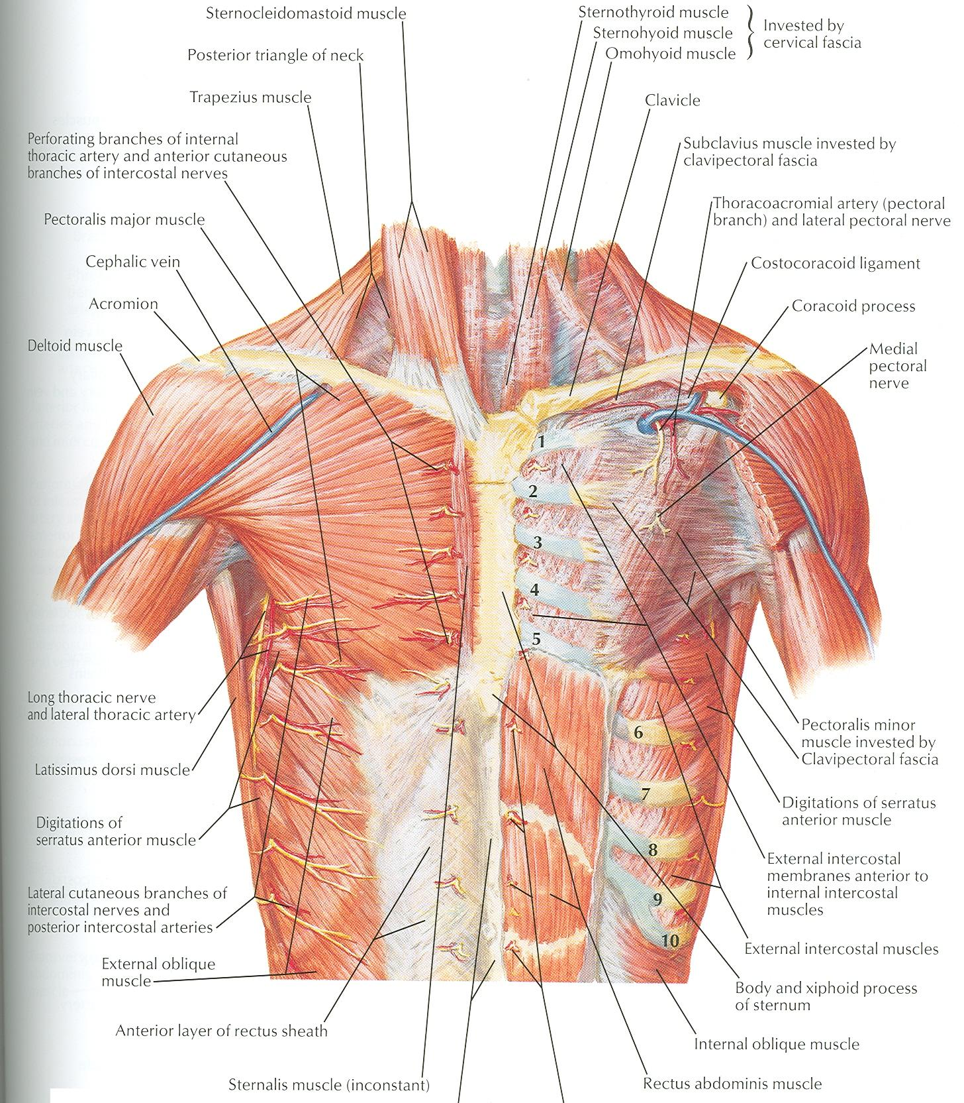

Slide 24
Subclavius
Origin: From the first costal cartilage
Insertion: Fibers move upward and laterally into the inferior surface of clavicle
NS: Nerve to the subclavius from upper trunk of brachial plexus
Action: Depresses the clavicle and steadies the bone

Slide 25
Pectoralis Minor
Origin: From 3rd, 4th and 5th ribs
Insertion: Coracoid Process
NS: Medial pectoral nerve, a branch of the medial cord of brachial plexus
Action: Pulls the shoulder downward and forward. Elevates the ribs of origin

Slide 27
Subscapularis
Origin: Subscapular fossa on the anterior surface of scapula
Insertion: On the lesser tuberosity of the humerus
NS: Upper and Lower subscapular nerves
Action: Medially rotates the arm and stabilizes the shoulder joint

Slide 28
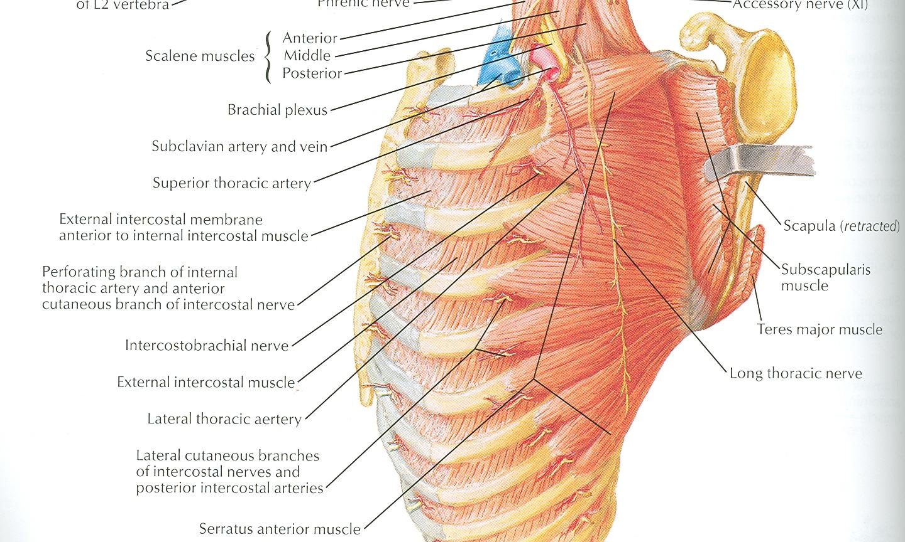

Slide 29
Latissimus Dorsi
Origin: Posterior part of the iliac crest, lumbar fascia and spines of lower 6 thoracic vertebrae, lower 3 ribs
Insertion: Floor of the bicipital groove of humerus with teres major
NS: Thoracodorsal nerve from posterior cord of brachial plexus
Action: Extends, adducts and medially rotates the arm

Slide 30
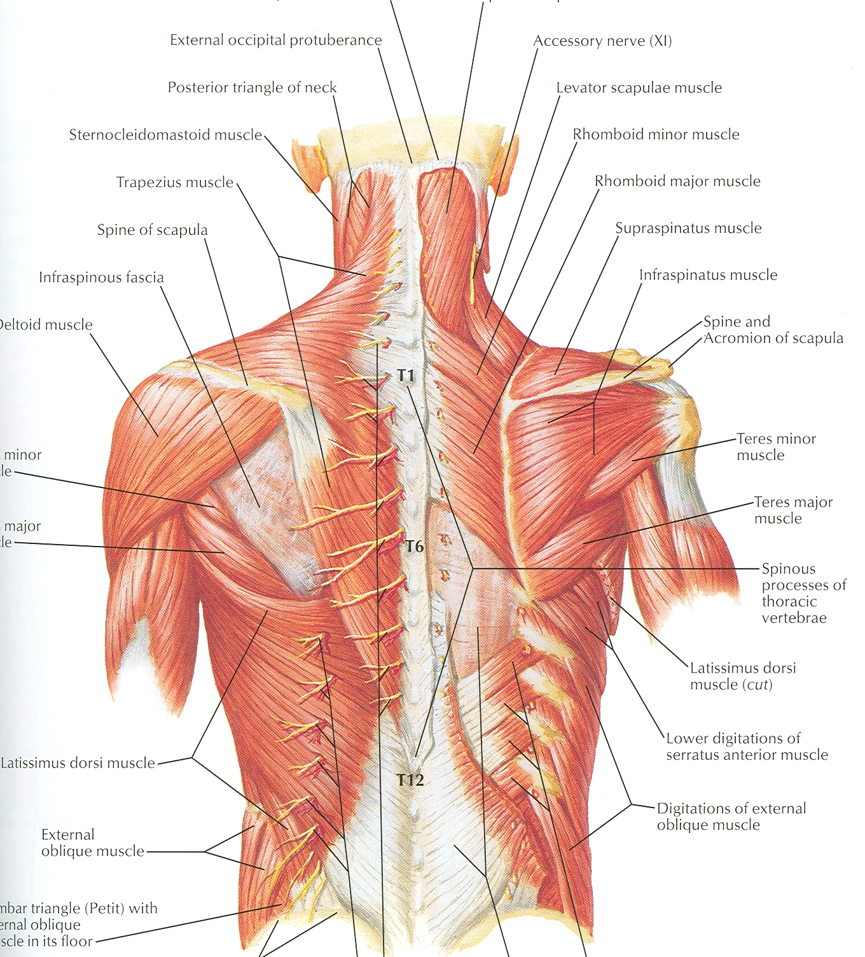

Slide 31
Teres Major
Origin: lower third of the lateral border of scapula
Insertion: Medial lip of bicipital groove of humerus
NS: Lower subscapular nerve from posterior cord of brachial plexus
Action: Adducts and medially rotates the arm

Slide 32
Serratus Anterior
Origin: From Outer surface of upper 8 ribs
Insertion: Medial border of scapula in the region of inferior angle
NS: Long thoracic nerve
Action: Draws the scapula forward, rotates it

Slide 34
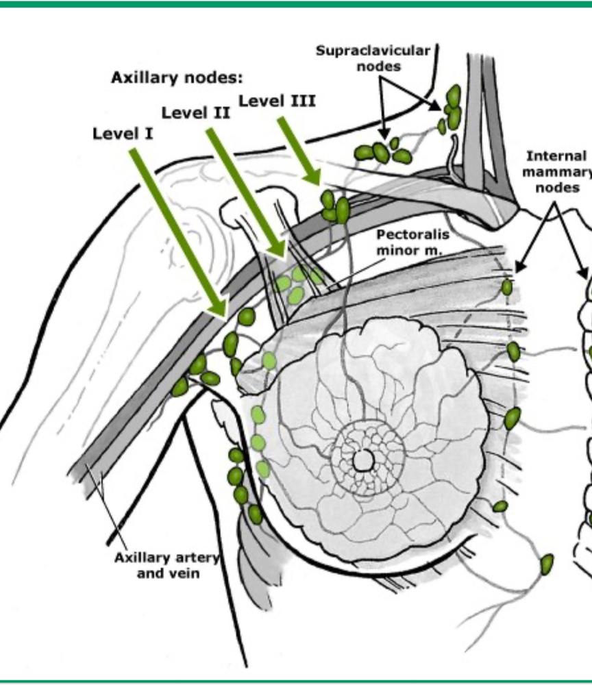
AXILLARY LYMPH NODES

Slide 35
AXILLARY LYMPH NODES
Anterior group(pectoral)
Lateral group(hemeral)
Posterior(subscapular)
Central
Apical : final common pathway for all axillary LN

Slide 36
APPLIED ANATOMY
regional anaesthesia: axillary block
bier’s block
central cathetherization
axillary lymphadenopathy
axillary dissection/ clearance
lymphadenitis
lymphedema

Slide 37
THANK YOU FOR LISTENING

